Slide 1

Healthcare Dialysis analysis

Slide 2


Group 4
Ritu Kishor Paigwar
Poornima Gopinathan
Chaitanyachidambar Kulkarni
Shital Kumbhar
Gaurav Tripati

Slide 3
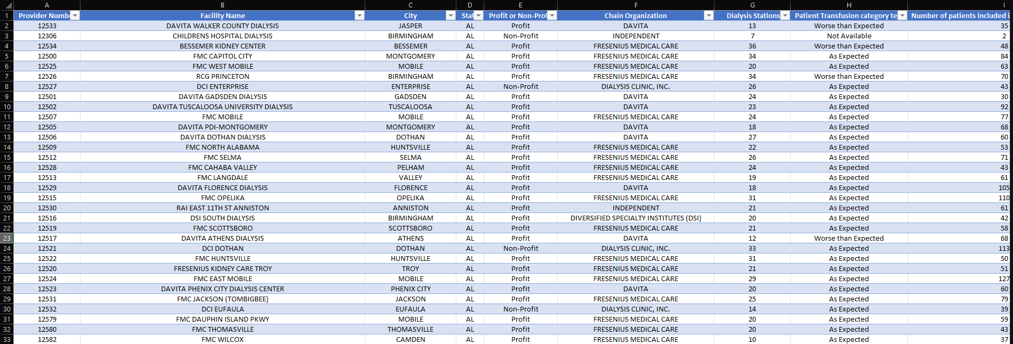
Understanding the Data

Slide 4






Key cards
5.73M
131K
89.14%
33.74
0.00834%
Total Number of Patients
Total Number of Dialysis Stations
Profitable Chain Organizations
Average Performance Score Per Chain Organization
Average Payment Reduction Rate

Slide 5
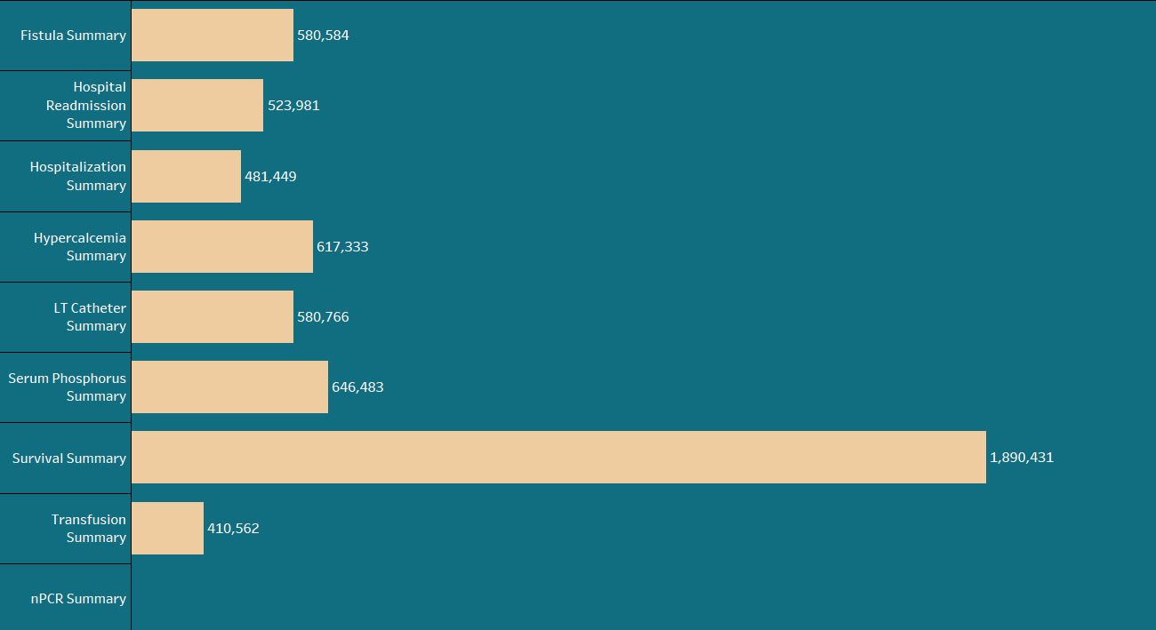
Summaries
INSIGHTS
The most common summary is Survival Summary, with a total of 1,890,431 patients. This suggests that the majority of patients referred to the isolation unit were admitted for treatment of kidney related diseases.
The next most common summary is Serum Phosphorus Summary, with a total of 646,483 patients. This suggests that hyperphosphatemia is a common complication of infectious diseases in humans.
The least common summary is nPCR Summary. This suggests that nPCR is not a commonly used diagnostic test for infectious diseases in humans.

Slide 6
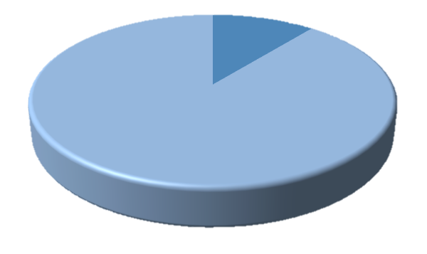
Profit vs non - profit
Non-Profit 10.86%
Profit 89.14%
INSIGHTS
The majority of the Chain Organization in the dataset are profitable. The "Profit" slice takes up 89.14% of the pie, while the "Non-Profit" slice takes up only 10.86%. This suggests that the business environment in the dataset is favorable for chain organizations to make a profit.

Slide 7
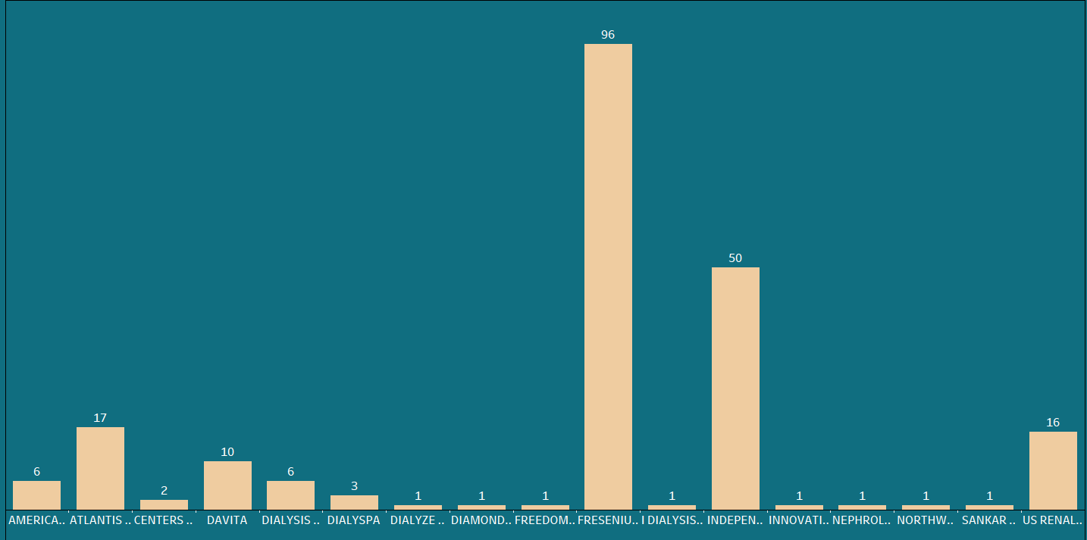
Chain organizations
INSIGHTS
The most common Chain organization having performance score as “No Score” is Fresenius Medical Care with a total of 96 No Score ratings.
Followed by Independent Chain Organizations having performance score as “No Score” with a total of 50 No Score ratings.

Slide 8
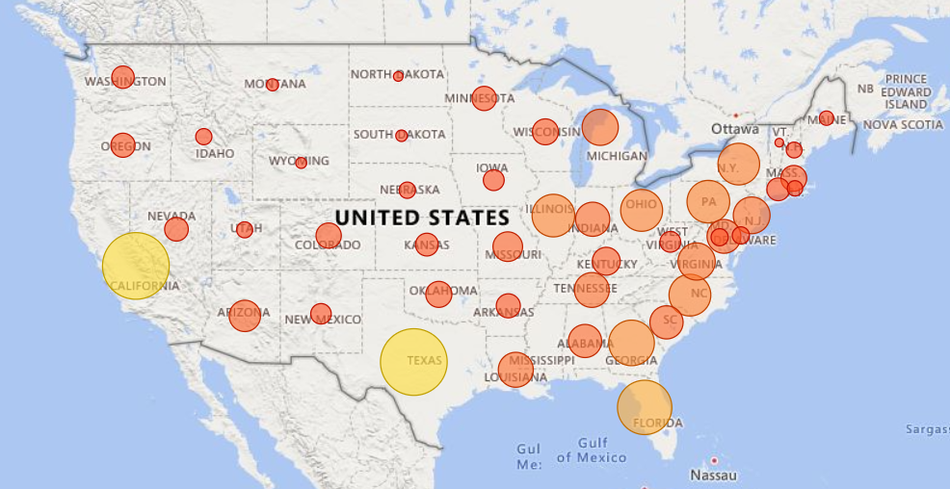
Total Dialysis Stations
INSIGHTS
The number of dialysis stations varies considerably across the country. Some states, such as California, Texas, and Florida, have a large number of stations, while others, such as Wyoming, North Dakota, and Alaska, have relatively few. This variation is likely due to a number of factors, including population density, the prevalence of kidney disease, and the availability of healthcare resources.

Slide 9
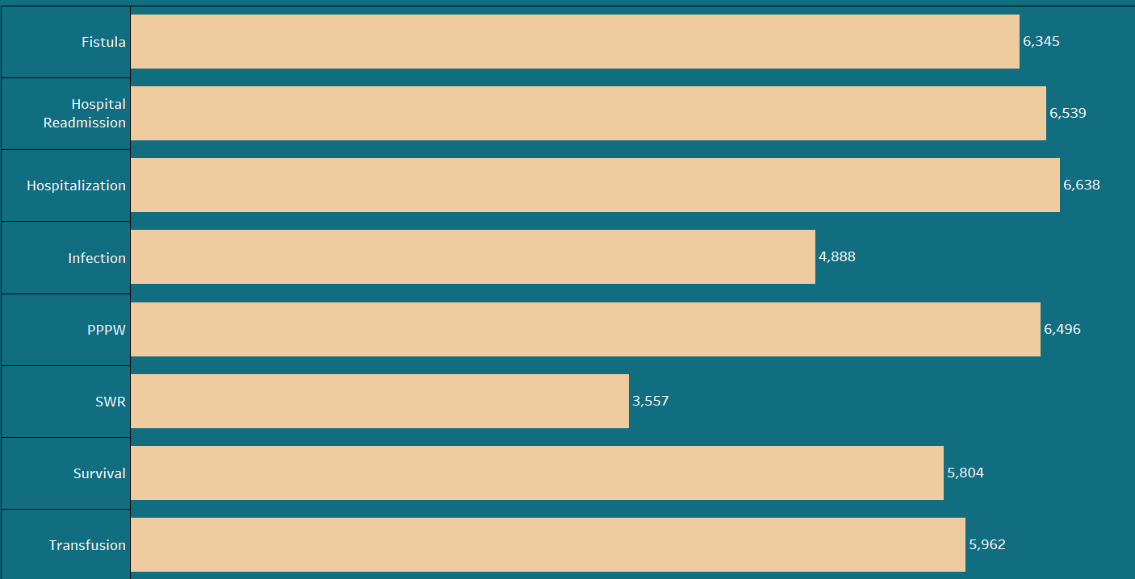
Categories
INSIGHTS
“Hospitalization” category has the highest number of "As Expected" results (6,638), followed by "Hospital Readmission" (6,539) and “PPPW" (6,496). This suggests that these categories might be well-understood or predictable in terms of outcomes.

Slide 10
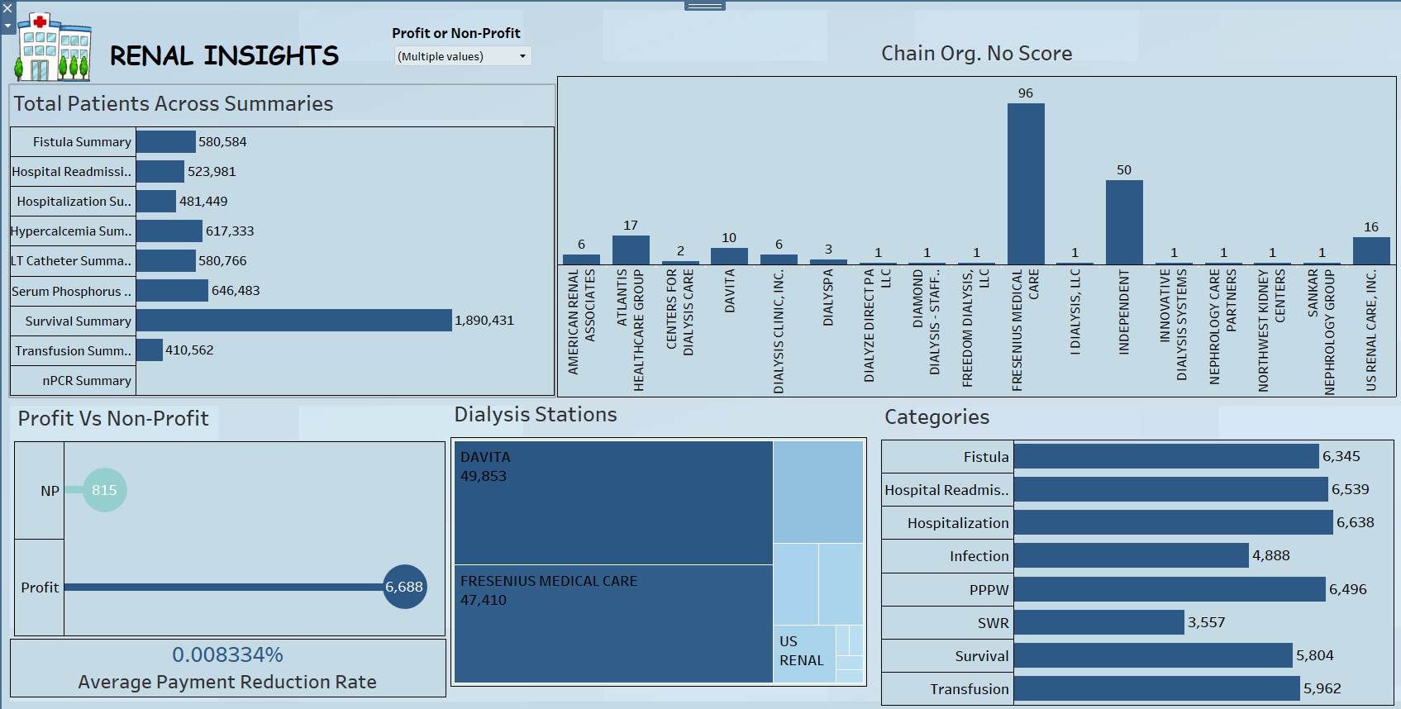

Slide 11
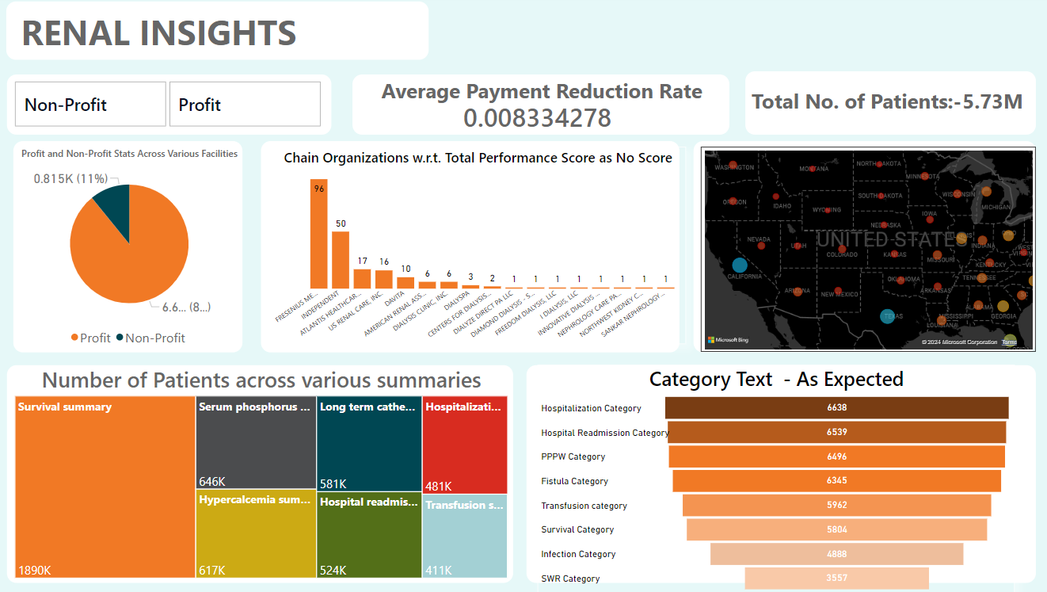

Slide 12
Conclusion
All things considered, the analysis shows predictability in hospitalization, readmission, and PPPW category results.
Population density is one element that influences the variability in the number of dialysis stations. Transparency concerns are raised by the frequency of "No Score" evaluations, particularly for Fresenius Medical Care.
The Dominance of profitable businesses indicates a favourable business climate.
Patient summaries show that nPCR is not often used as a diagnostic test for infectious infections, despite a high rate of hospitalizations due to kidney problems.
These revelations highlight the need for additional research and possible advancements in medical procedures.

Slide 13

Thank you

